Slide 1

CAN YOU TRUST
IT？
CREATOR INFORMATION

Slide 2
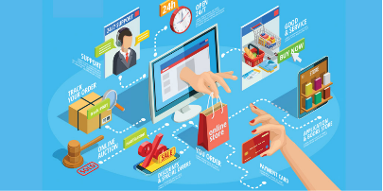
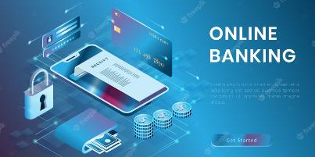
CONTENTS
01. INTRODUCTION
02. BACKGROUND
03. ANALYSIST
04. CONCLUSION

Slide 3
INTRODUCTION
Legal
Online Purchase
ADVANTAGE
Ethical
Social
Challenge
Online Banking
Conclusion

Slide 4
ONLINE BANKING

Slide 5
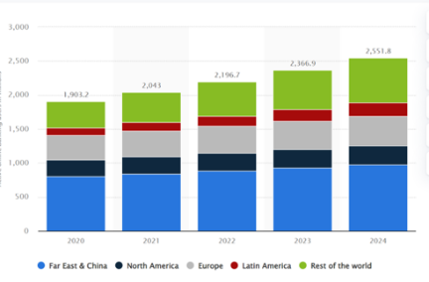

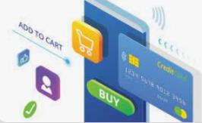
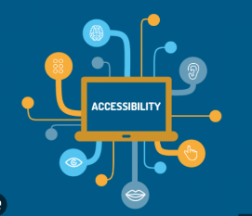
Online banking presents
a growing trend.....
(Number of active online banking in 2020 forecasts from 2021 to 2024)
Convenience
Security
Accessibility

Slide 6

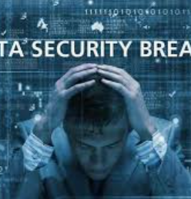

CHALENGE
Hackers can gain access to sensitive information such as account numbers, passwords and financial data.
Security Breches
Old People
Older people can have difficulty adapting to new technology and navigating complex digital interfaces.
Hackers can gain access to sensitive information such as account numbers, passwords and financial data.

Slide 7

Comprehensive Analysis
Online banking has changed the way we manage our finances, offering many benefits such as convenience, security and accessibility. However...
SOCIAL
ETHICAL
LEGAL
IIncreased convenience, efficient money management, and expanded financial inclusion.
Exacerbated digital divide, excluding segments lacking access and digital literacy.
the main concern revolves around privacy
Privacy concerns and risks of identity theft compromise customer trust.
online banking is subject to various regulations and laws.
Failing to adhere to these legal requirements can lead to severe consequences
RE：the General Data Protection Regulation(GDPR)

Slide 8

ADVICE
Banks prioritize robust security measures: encryption, authentication, and fraud detection.
Transparency and consent are crucial: clear communication of data practices and customer consent for data sharing.
User education and support enhance privacy and online banking security.

Slide 9
ONLINE PURCHASING

Slide 10
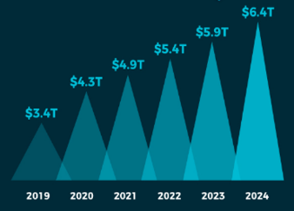


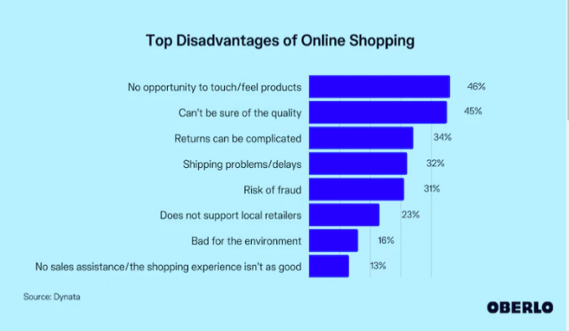
online purchasing has been a unique part of human life.....
(Global eCommerces Sales USD)2019-2024
6.4T USD
CHALLENGE
NO FEEL PRODUCTS
CANT SURE QUALITY
Convenience
Best Prices

Slide 11


CHALLENGE
Hackers can gain access to sensitive information such as account numbers, passwords and financial data.
No opportunity to touch/feel products
Can’t be sure of quality
45% of consumers say that buying products online poses a problem when they cannot be sure of the quality of the items they’re acquiring.
As many as 46% of consumers surveyed say this is a drawback of purchasing items online.

Slide 12
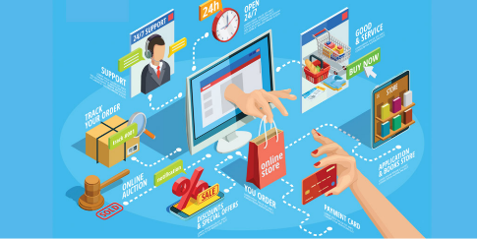
Comprehensive Analysis
SOCIAL
ETHICAL
Online shopping data breaches undermine trust, impacting company credibility and revenue. They also fuel criminal activities involving the sale of personal information, affecting society negatively.
LEGAL
Online shopping site or application have an obligation to protect the user's personal information safety, once appear, personal information leakage.
Companies often seek advance consent for personal data usage, which is legal. However, illegally disclosing user information for profit remains a concern.

Slide 13
ADVICE
For individuals, learn to prevent information leaks and know how to respond if a breach occurs.
For companies, invest in site security to prevent hackers and fulfill the duty of protecting users' personal information.
For society, promote privacy protection, enact relevant laws, and regulations to address information disclosure.

Slide 14
CONCLUSION
Concerns over online banking and shopping highlight the need for caution and trust in IT.
Legislation and regulations play a crucial role in enhancing network security and addressing these concerns.
Additionally, promoting cybersecurity awareness and fostering collective commitment can mitigate risks, ensuring a safer digital landscape for all.
Therefore, although IT cannot achieve 100% security, at least it is striving towards 100%.

